Slide 1
Introduction to Electrical Machine Design
By.Prof.NAHID KHAN
Anjuman College of Engg. & Tech.,Nagpur

Slide 2
DESIGN OF TRANSFORMER

Slide 3
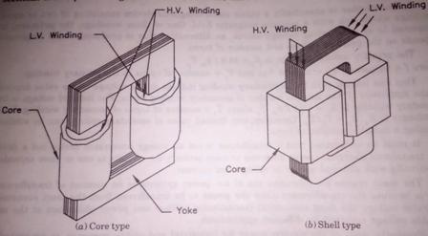
Classification of transformer
Depending upon the type of construction used:
I.Core type
II.Shell type

Slide 4
Comparison of core type and shell type transformers:- I.Construction:- II.Mechanicalforces III.Leakagereactance IV.Repairs V.Cooling

Slide 5
Classification on the basis of type of service:
I.Distribution transformer
II.Power transformer
Classification on the basis of power utility:
I.Single phase transformer
II.Three phase transformer

Slide 6
Construction of transformer
I.Transformer core
II.Winding
III.Insulation
IV.Tank
V.Bushings
VI.Conservator and breather
VII.Tapping and tap changing
VIII.Buchholz Relay
IX.Explosion vent
X.Transformer oil

Slide 7
Output equation of transformer
Single phase transformer :
Q = 2.22 ƒ Bm δ Kw Aw Ai.10-3 kVA
Three Phase
Q = 3.33 ƒ Bm δ Kw Aw Ai.10-3 kVA

Slide 8
Optimum design
Transformer may be designed to make one of the following quantity as minimum:
i.Total volume
ii.Total weight
iii.Total cost
iv.Total loss

Slide 9
Design of core
Rectangular core
Square and stepped cores

Slide 10
Square and Stepped core

Slide 11
Cross-section and dimensions of Stepped cores

Slide 12
Choice of flux density
The values of maximum flux density for transformers
i.For hot rolled silicon steel
Distribution Transformer1.1 to 1.35
Power transformer1.25 to 1.45
ii.For CRGO core
Upto132 kV1.55
For 275 kV1.6
For 400kV& Gen. Transf.1.7 to 1.75
15

Slide 13
Design of insulation
Electrical considerations
Eddy current losses
Leakage reactance
Mechanical considerations
Thermal consideration
Window Space Factor: It is the ratio of copper area in the window to the total window area.
Kw= 10/(30+kV)for transformer rating 50 to 200kVA
Kw= 12/(30+kV)for rating about 1000 kVA
Kw= 8/(30+kV)for rating about 20 kVA

Slide 14
Window dimensions:
Area of window Aw=total conductor area / window space factor
=2.apTp/Kwfor1-phtransformer
=4.apTp/Kwfor3-phtransformer
Aw = Hw x Ww
The ratio of Hw/Ww is 2to4.

Slide 15
Design of Yoke
Ay= Dy x Hy
Ay=1.15to1.25 of Agi
Ay =Agi for CRGO

Slide 16
Overall dimensions
Single Phase Transformer
D=d+Ww,Dy=a
H=Hw+2Hy
W=D+a

Slide 17
Three PhaseTransformer
D=d+Ww,Dy=a
H=Hw+2HyW=2D+a

Slide 18
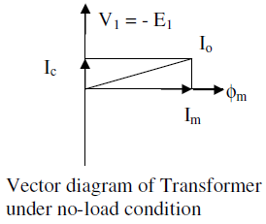
No-load current of transformer

Slide 19
Cooling of transformer
Methods of Cooling of Transformers
Cooling of Dry-type transformer
AirNatural(AN),AirBlast(AB)
Cooling of oil immersed transformer
OilNatural(ON)
OilNaturalAirForced(ONAF)
OilNaturalWaterForced(ONWF)
ForcedCirculationofOil(OF)
i.OilForcedAirNatural(OFAN)
ii.OilForcedAirForced(OFAF)
iii.OilForcedWaterForced(OFWF)

Slide 20
THANK YOU

